Slide 1
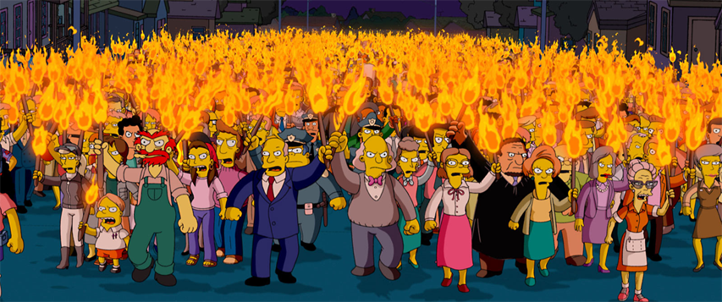
Put down the pitchforks
and pick up a keyboard
Notes:
TODO: ONCE WE’RE SET, CONVERT FONT TO IMAGE

Slide 2
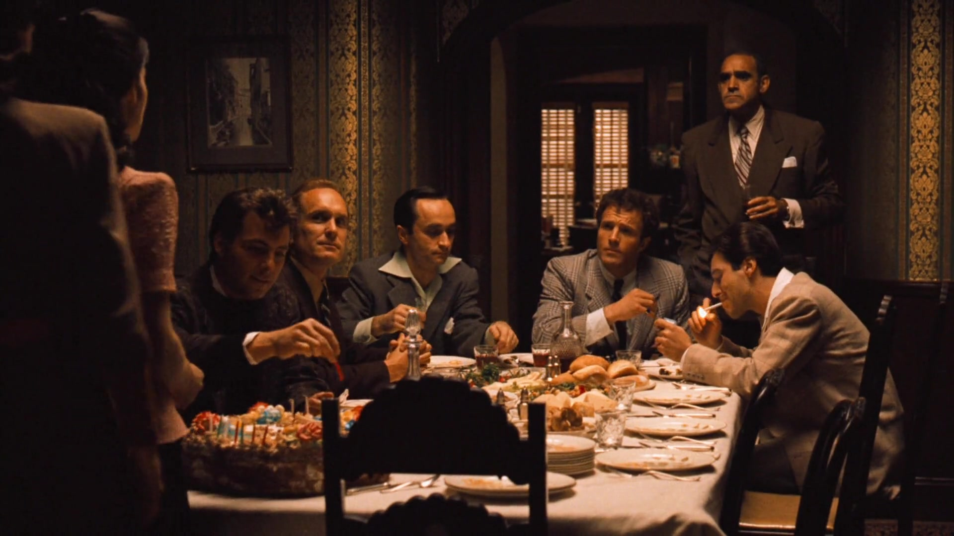

Mob Programming

Slide 3

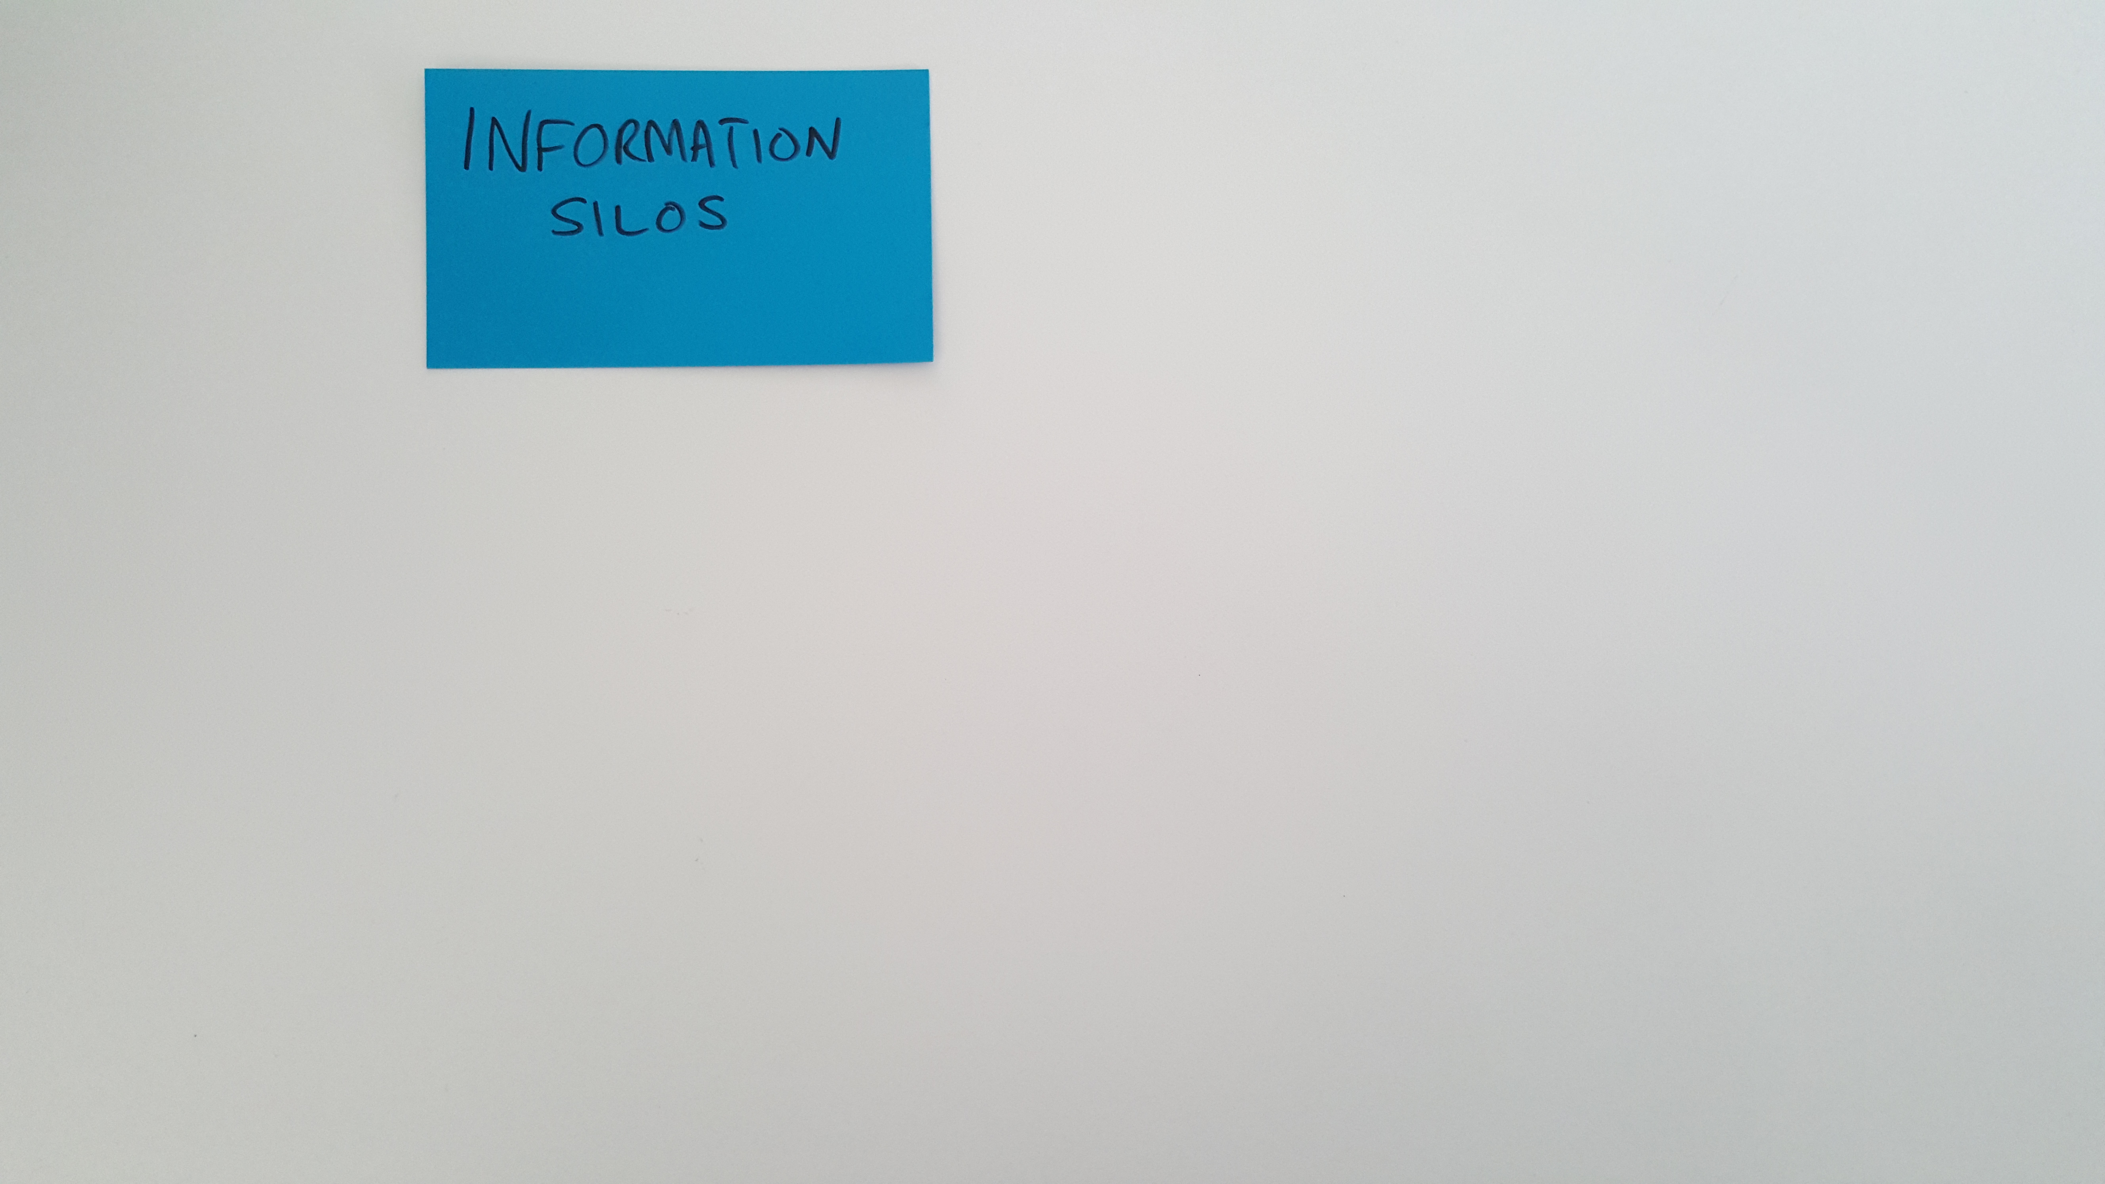
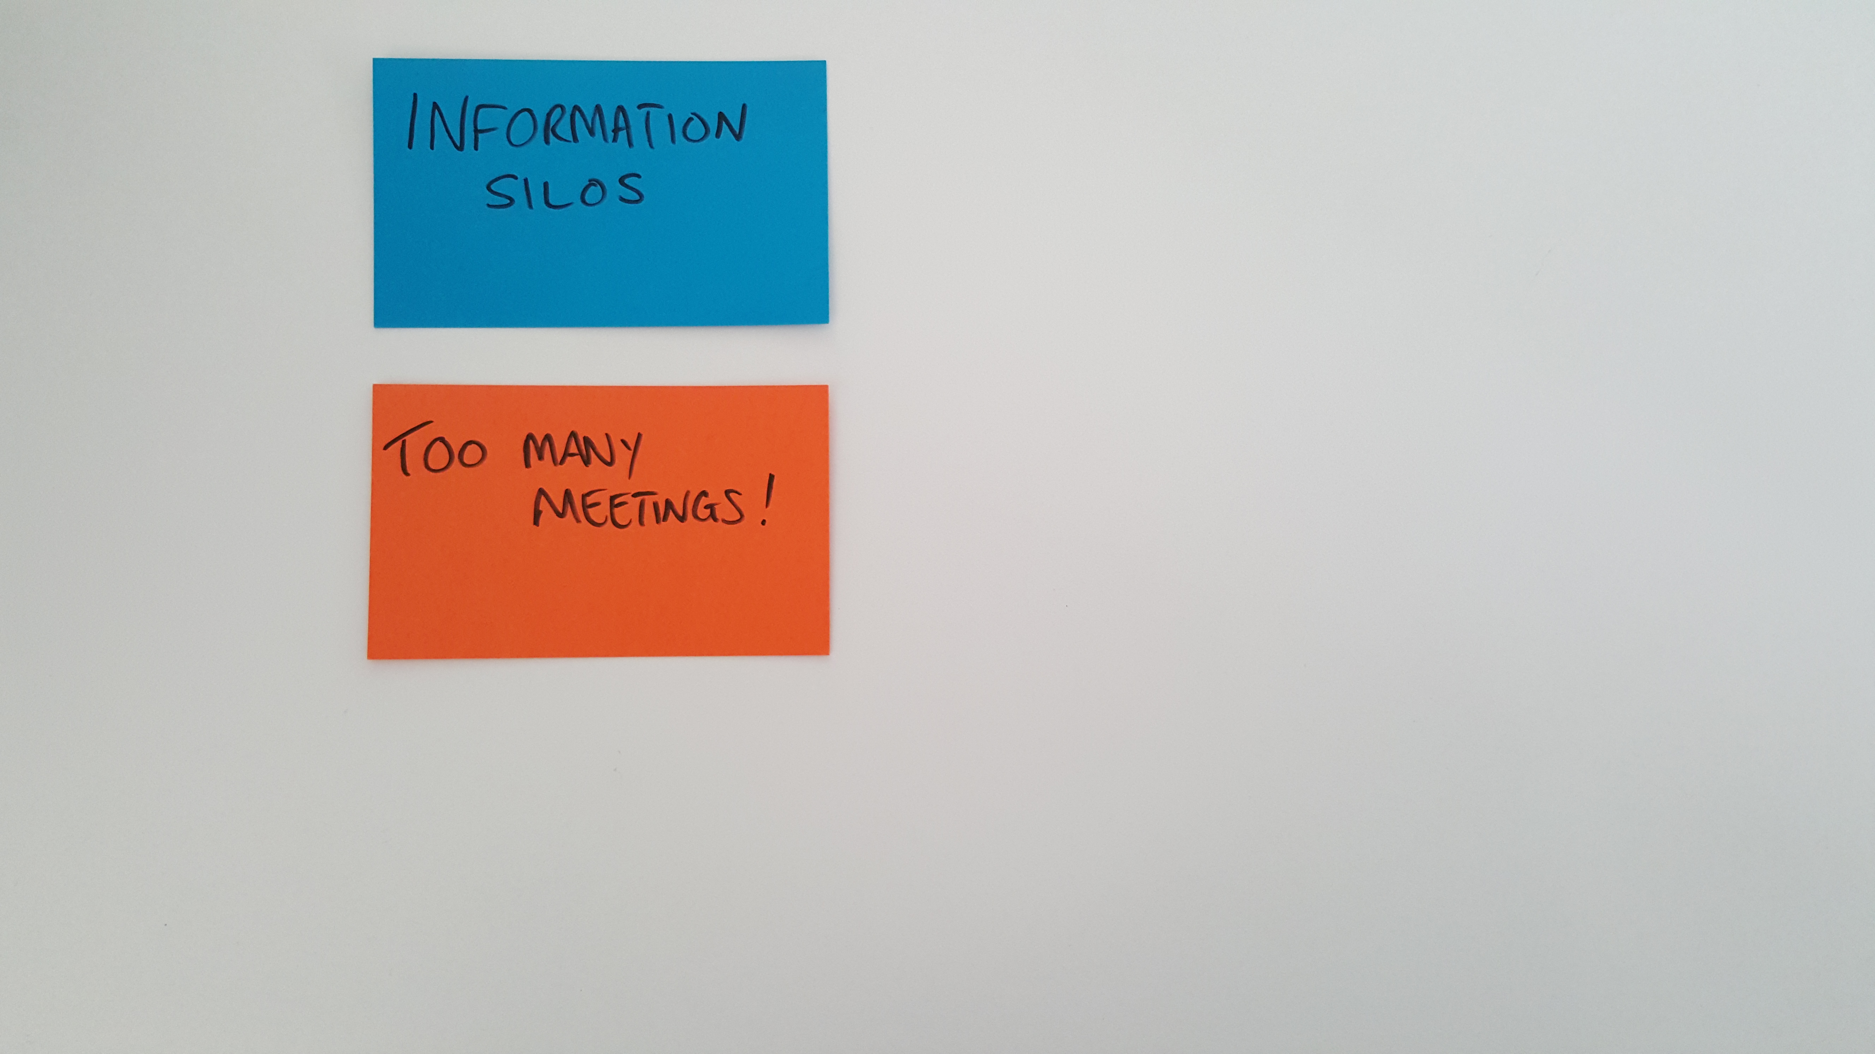
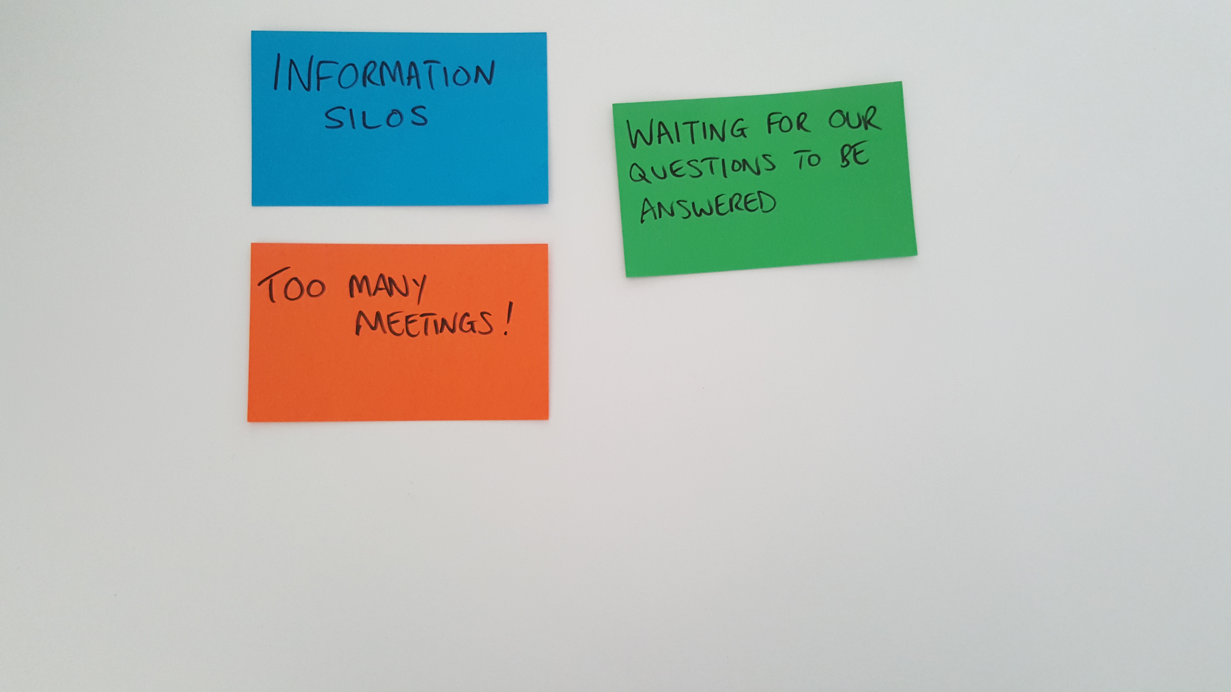
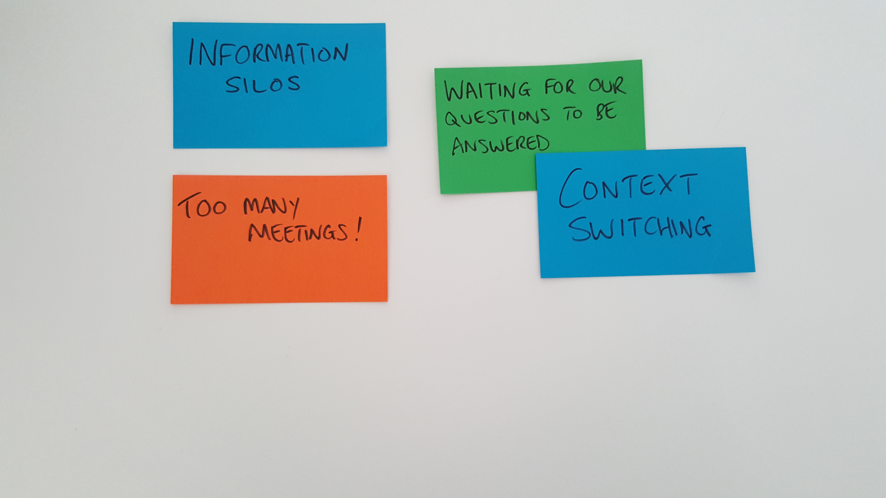
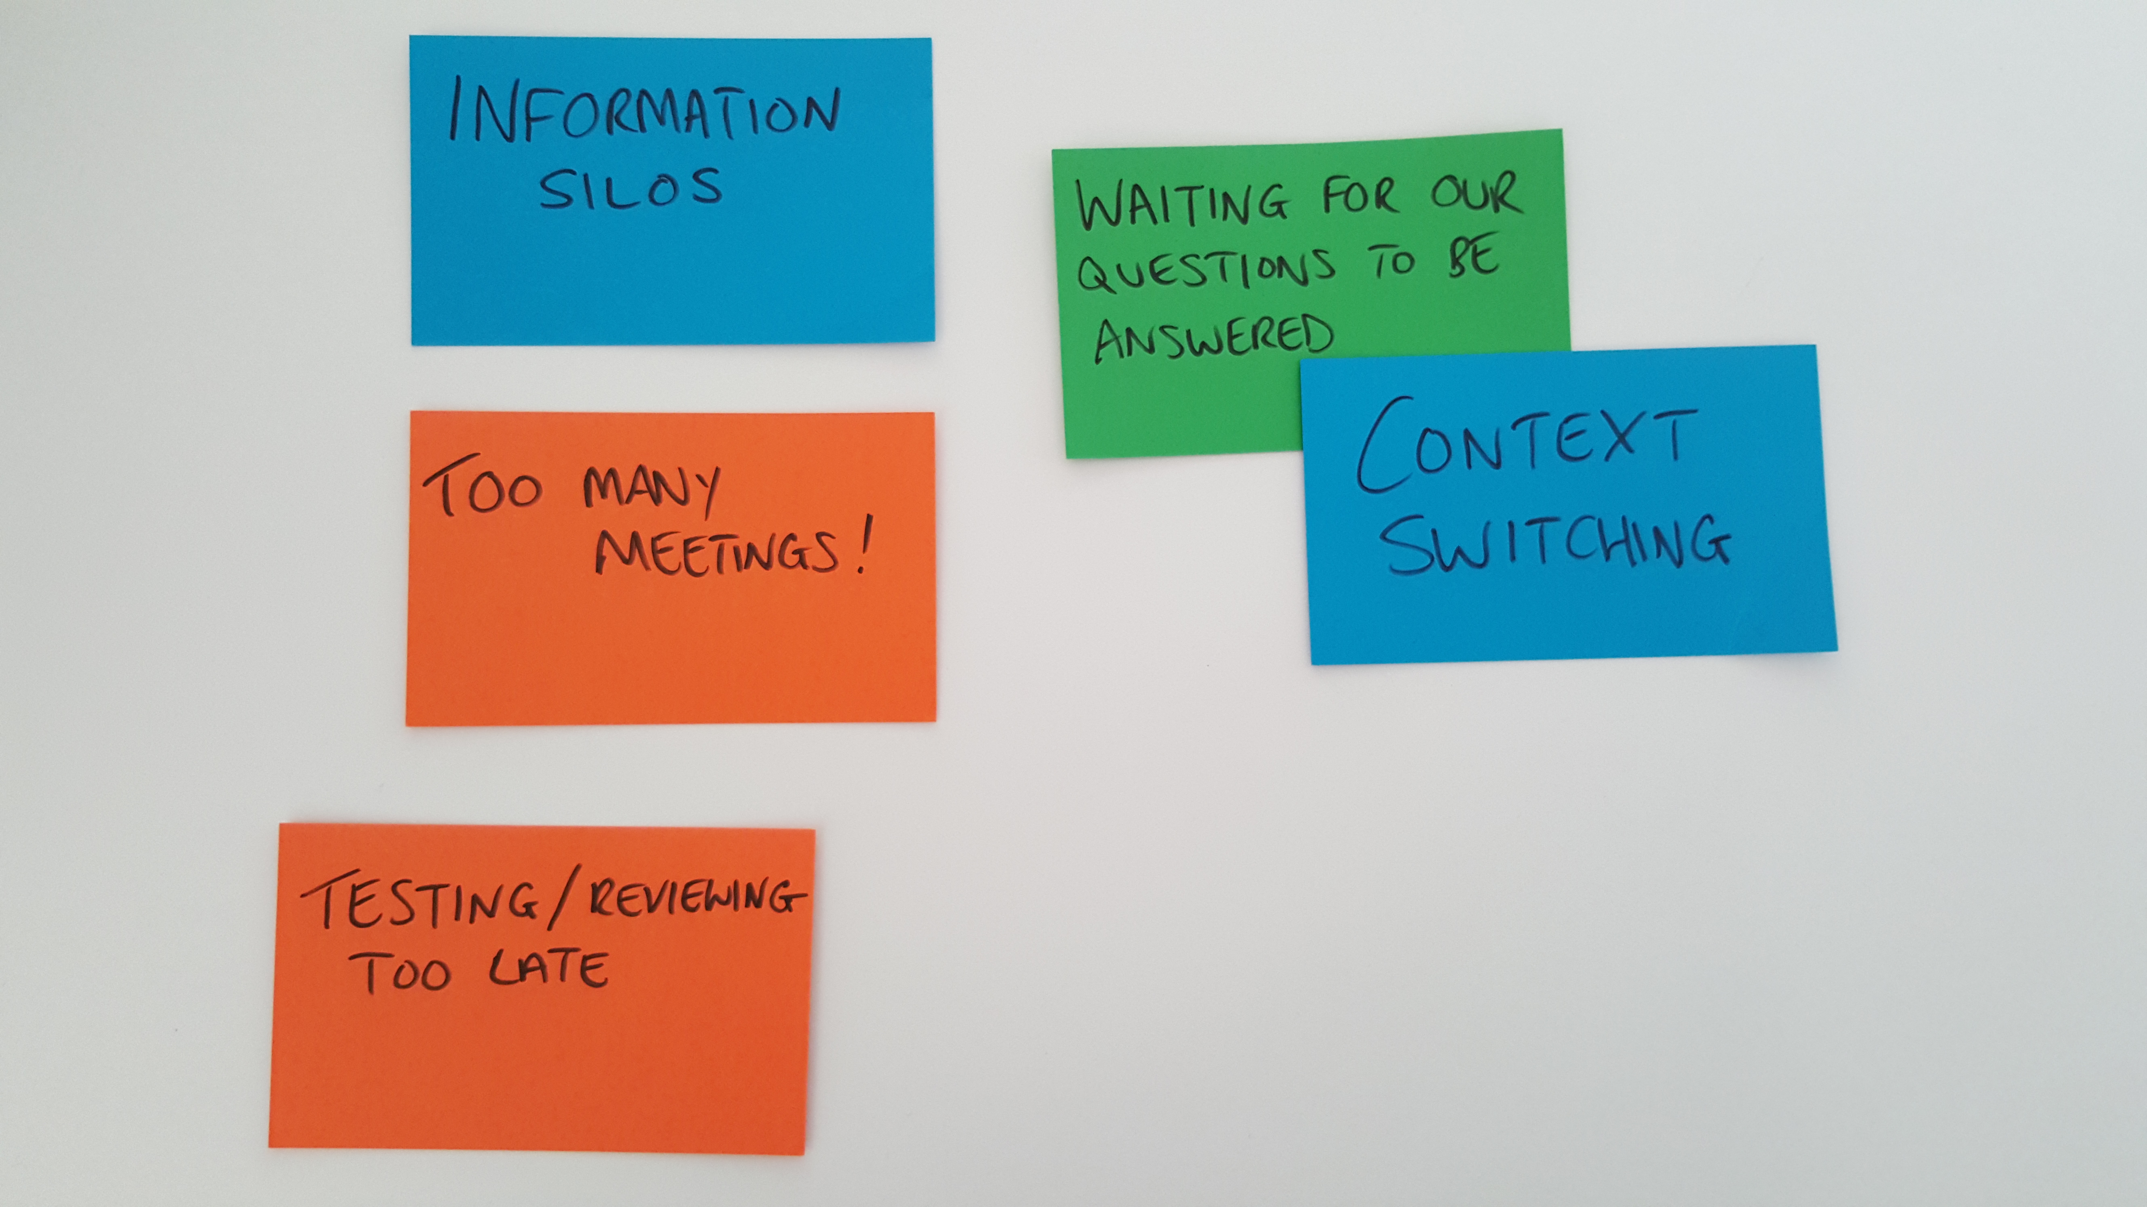
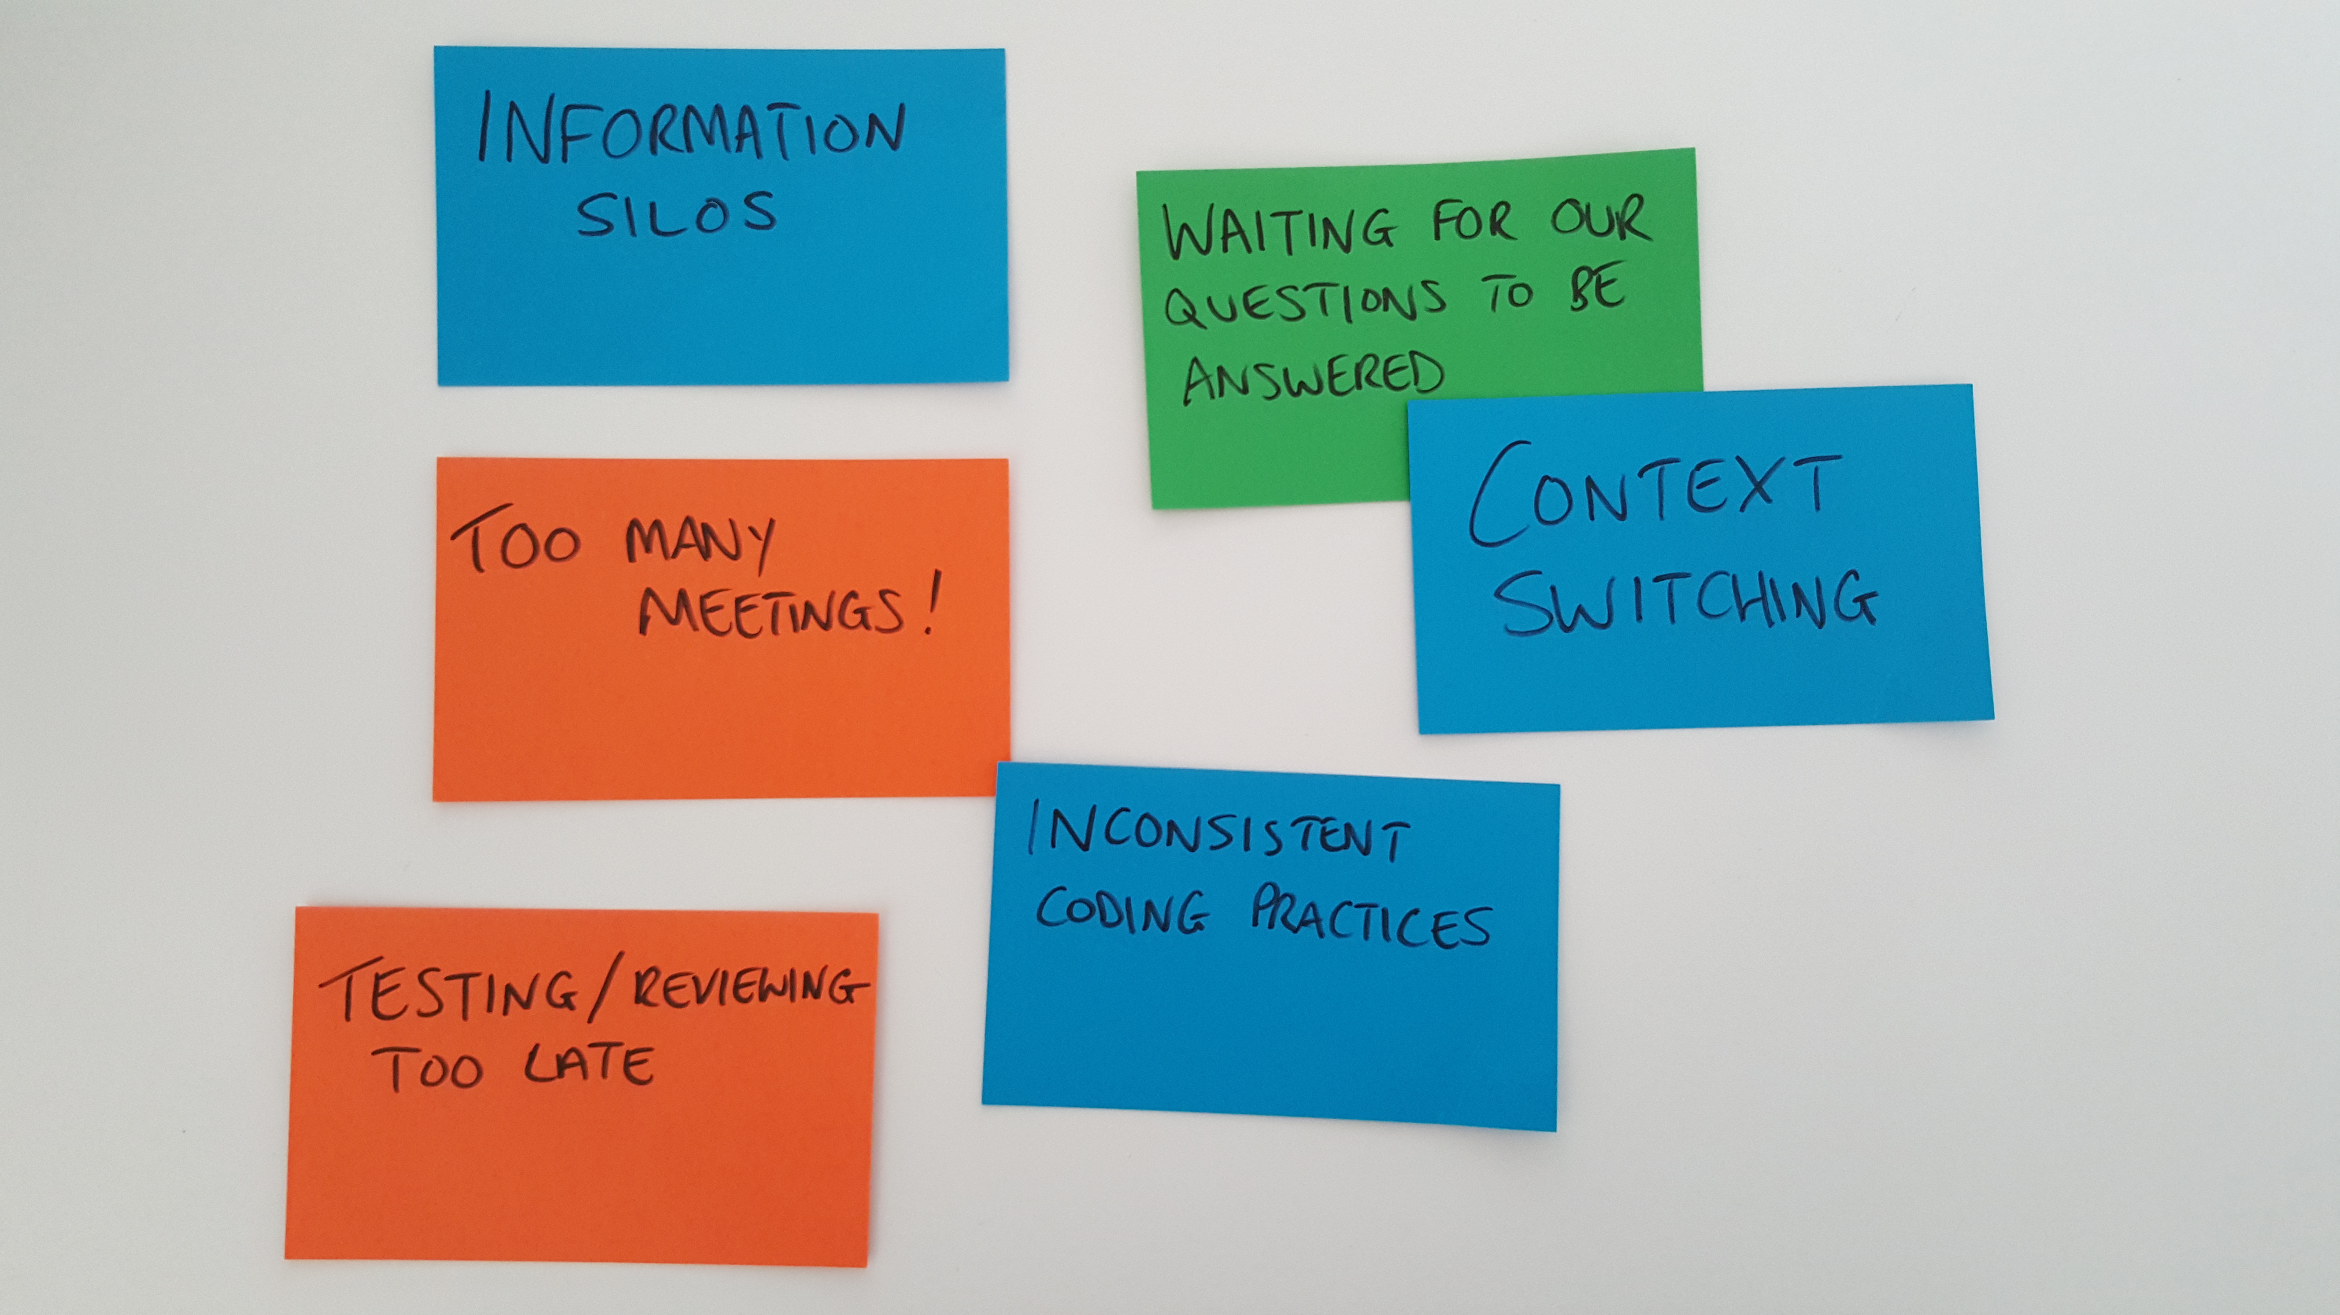
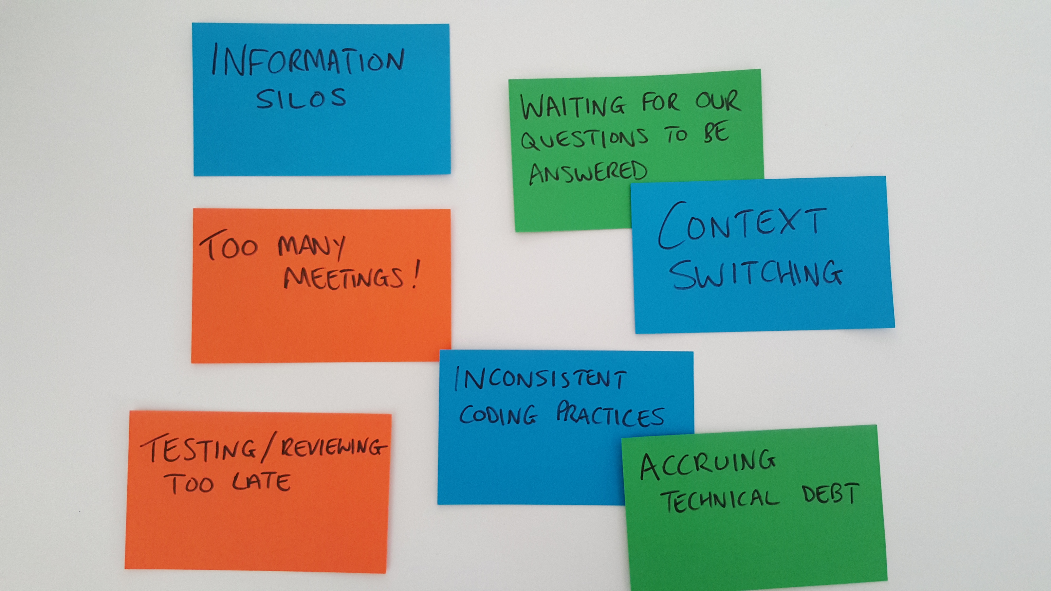
Notes:
NEIL
AUDIENCE: TYPICAL PROBLEMS IN DEVELOPMENT
Challenges we face – mini retro
Waiting for answers: “Question Queue Time”
All difficult to solve, but all can be made easier with mob programming

Slide 4
“All the brilliant people working on the same thing, at the same time, in the same space, and on the same computer”
- Woody Zuill
Notes:
OLI
WHO HERE HAS HEARD OF MOB PROGRAMMING BEFORE?
WHO’S ACTUALLY DONE IT?
Invented by Woody Zuill when he was working at Hunter Industries
Most of this is what we try to do in agile anyway. The last bit is the interesting extra twist.

Slide 5
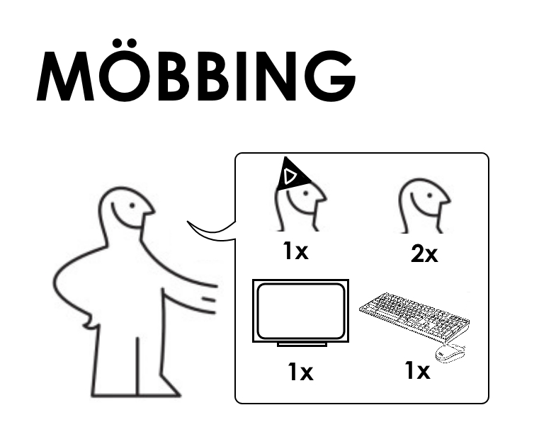

Slide 6
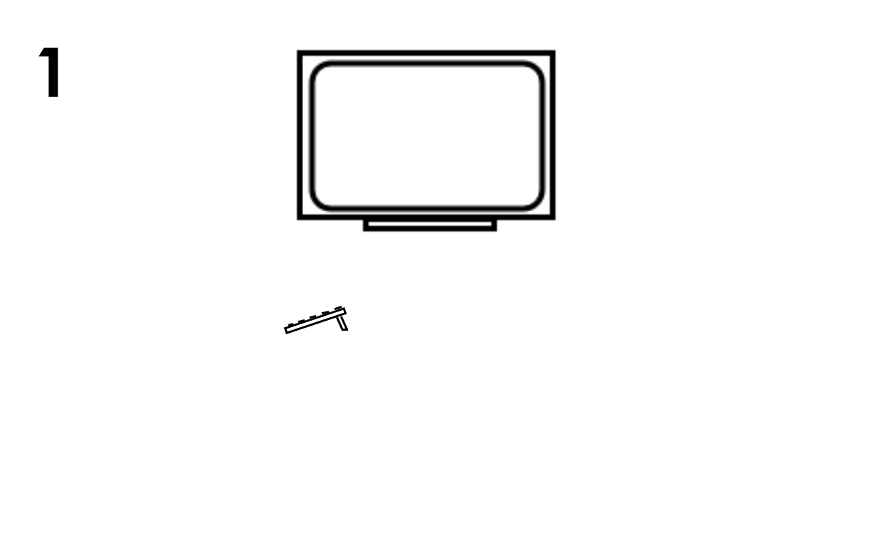

Slide 7
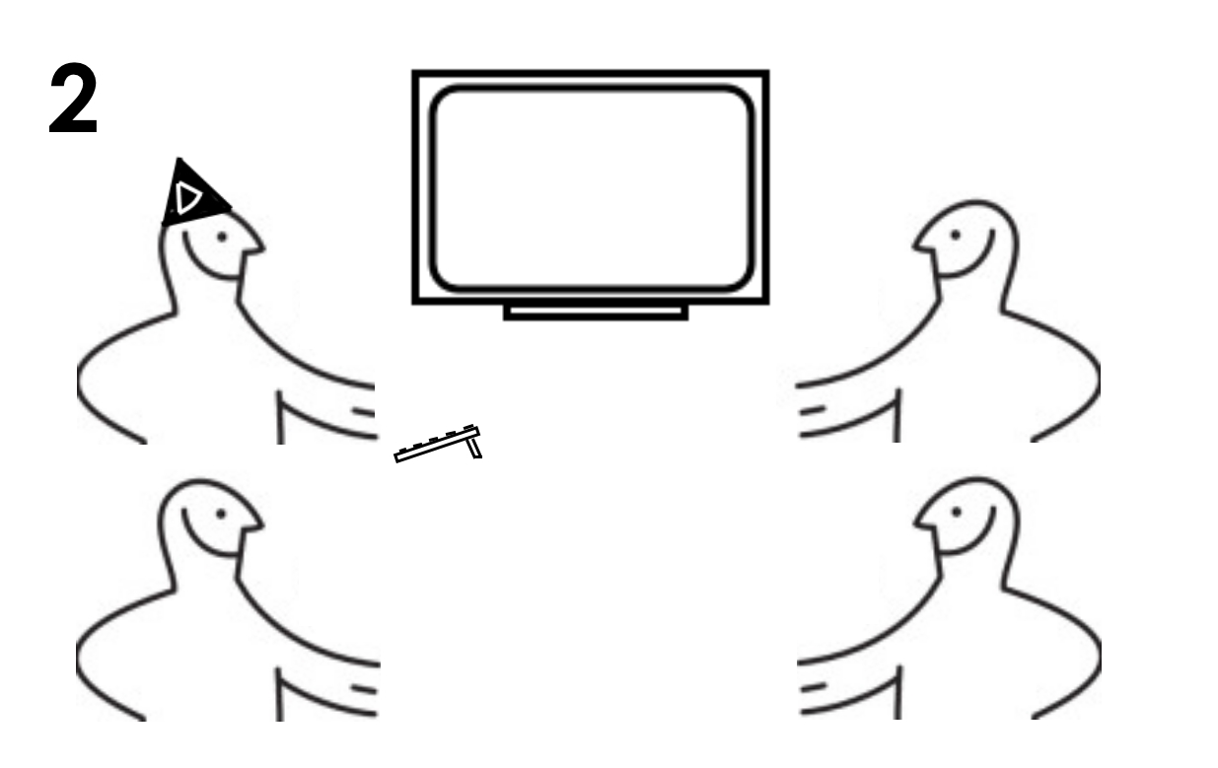

Slide 8
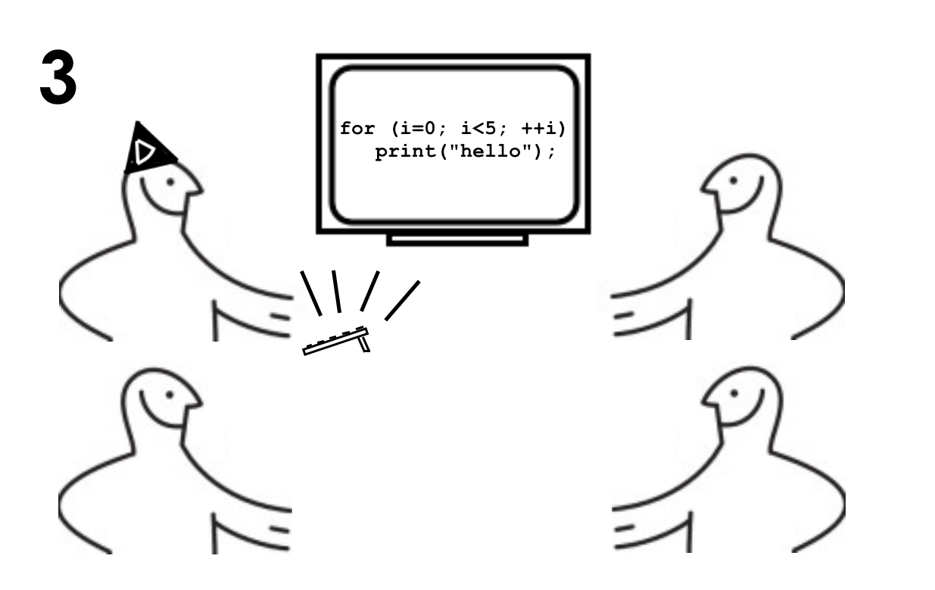

Slide 9
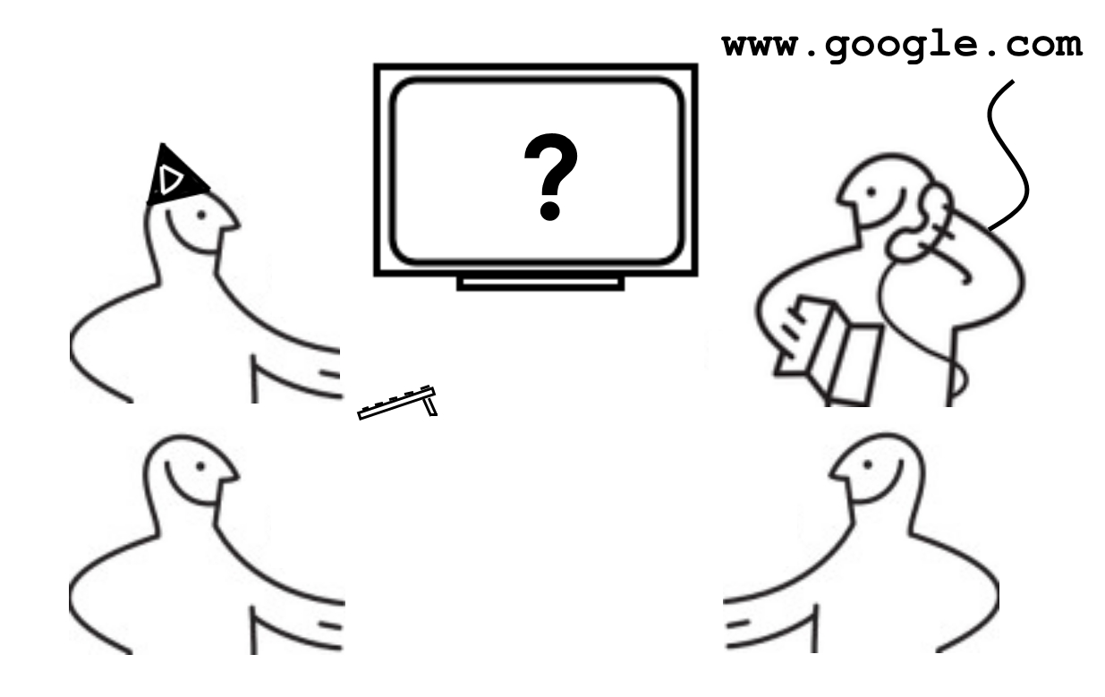

Slide 10
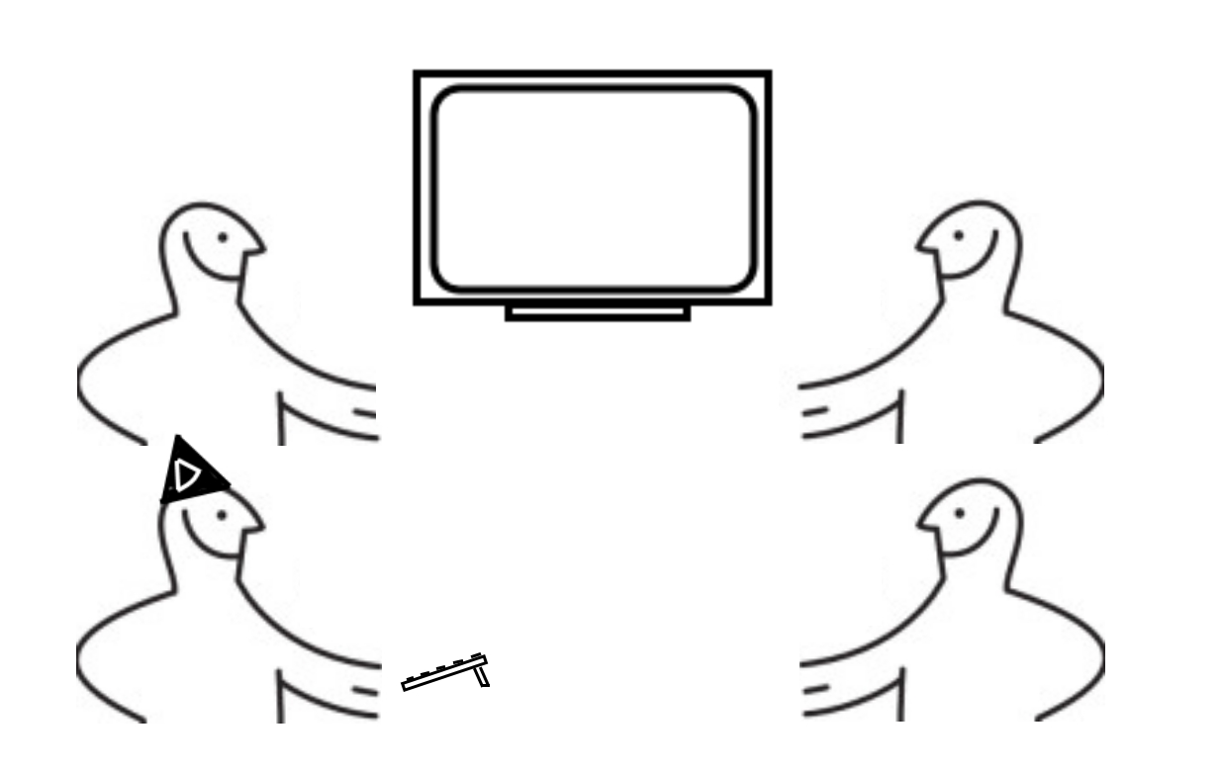

Slide 11
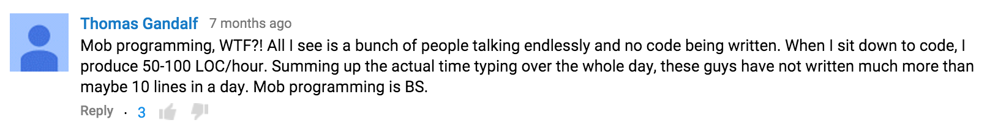
Concerns in a nutshell
It’s wasteful/inefficient
You’re using [x] people to do 1 or 2 people’s work!
We don’t have the resources to work that way
Notes:
NEIL
10 lines – definitely an exaggeration
“I am someone who writes code, they don’t write as much code as I do”
Measuring progress by lines of code is BS!

Slide 12
Concerns in a nutshell
There’s more to programming than code…
Analysing requirements
Deciding how to solve a problem
Agreeing on an approach
Creating examples/scenarios
Implement a ‘walking skeleton’
Decide if it’s fit-for-purpose
Agree on refactoring
Reviewing with stakeholders
Notes:
NEIL
…Not many of these things require hands on a keyboard
…Many of them involve multiple people having a conversation
…With mobbing, those people are already in the same place at the same time

Slide 13

EMERGENT DESIGN
KNOWLEDGE SHARING
DEBATE
CODE REVIEW
CONSISTENCY
LEARNING
INCLUSIVE
Notes:
OLI

Slide 14
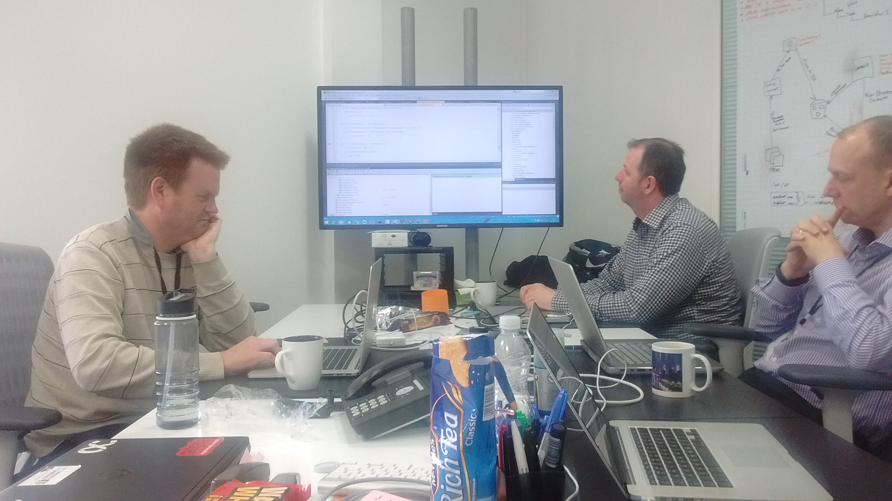
Driver
Central Monitor
(HDMI / DVI / VGA)
Navigators
Pens, paper,
whiteboards
for sketching
Similarly-specced machines (plus a wireless keyboard/mouse)
Tea and biscuits
Notes:
NEIL
We had a row of pairing monitors to begin with
This is good. Haven pods are even better (isolation from noise/distraction)
Same VS versions, same Resharper versions, same preferences for e.g. line endings

Slide 15
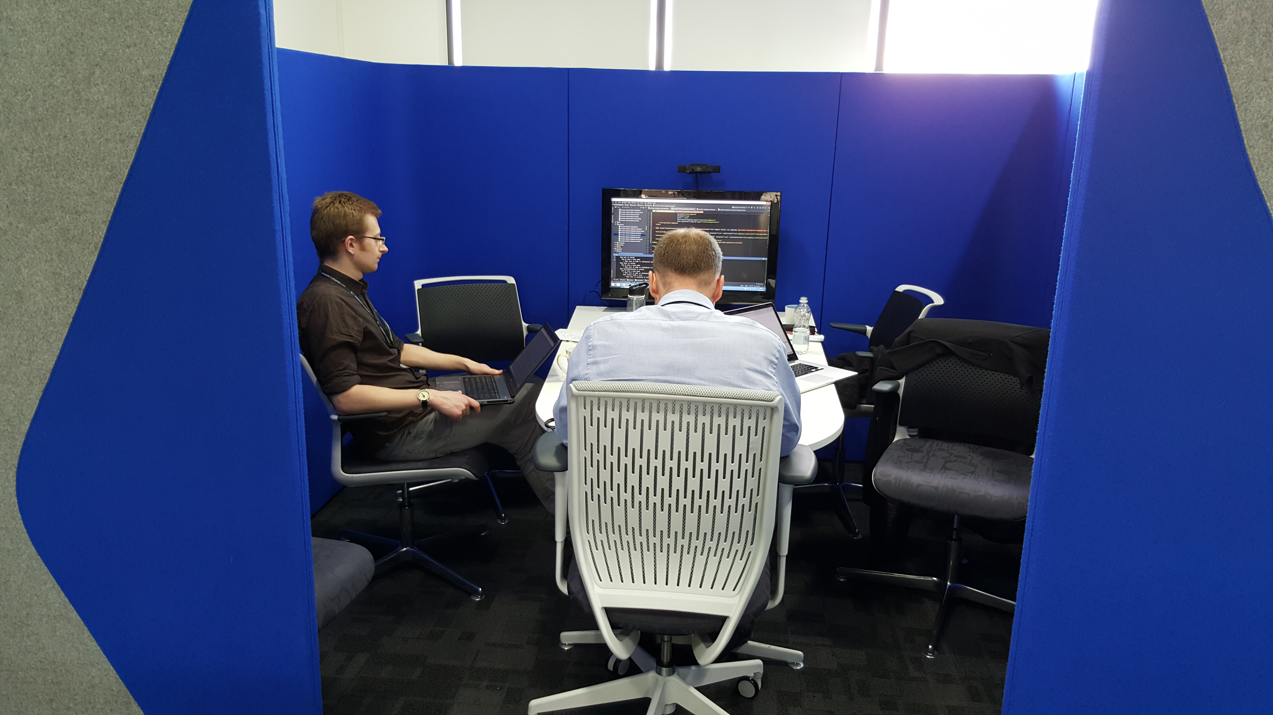
Monitor and webcam
Isolated from noise
(incoming and outgoing!)
Notes:
NEIL

Slide 16
Tricks of the trade
Line numbers
Sidebar
Mobbing remotely
Notes:
OLI
Talk about what we can still do better? (or use that as a lead-in to the next slide)

Slide 17
MOBBING: THE CHALLENGES
Notes:
NEIL

Slide 18
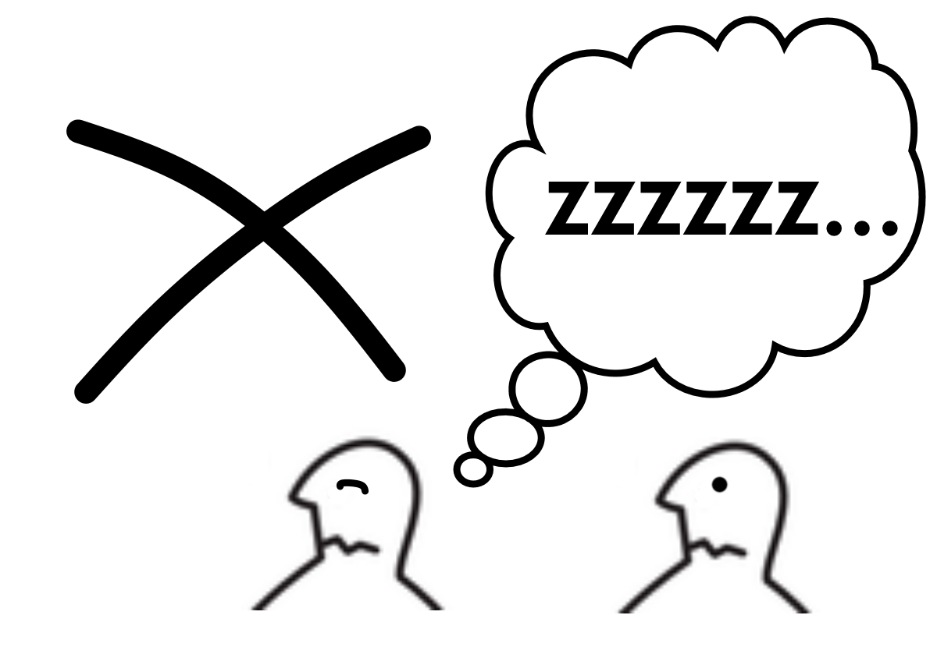
NOT EVERY TASK IS SUITABLE
Notes:
NEIL
That’s OK. We’re not saying you should mob 24/7.
We favour mobbing, but evaluate each task for suitability.

Slide 19
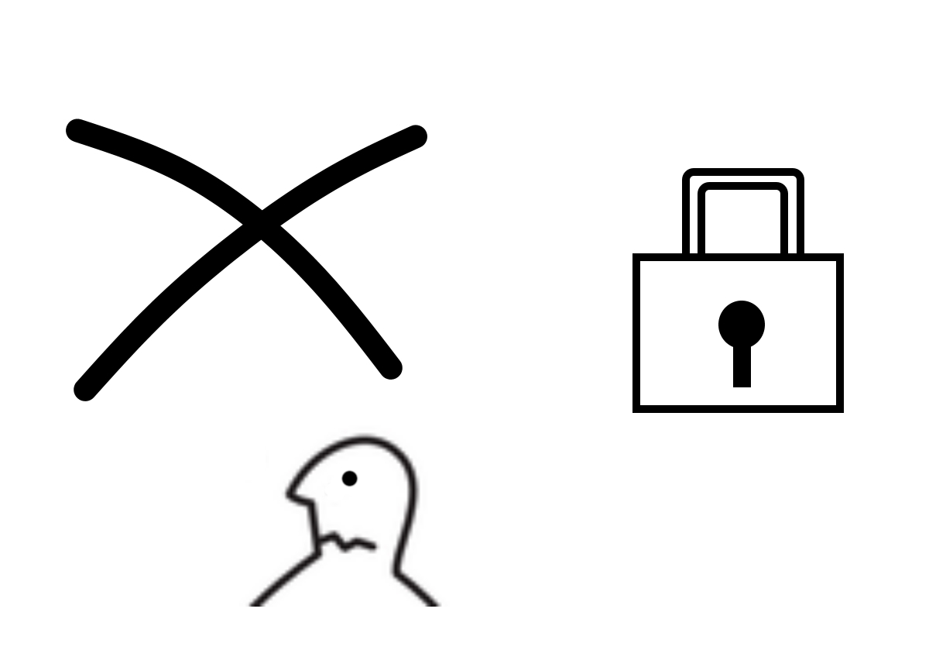
SPLITTING ISN'T A SIN
Notes:
OLI - …but don't be too precious about the mob​
(splitting is not a sin)​

Slide 20
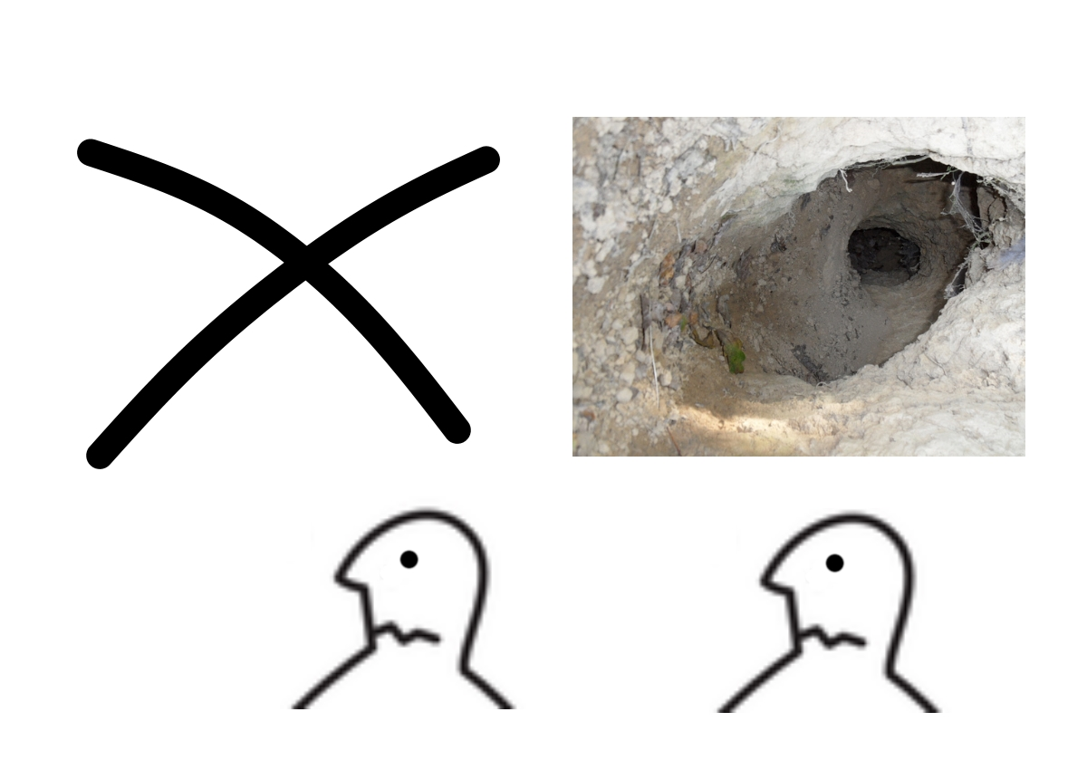
BEWARE RABBIT HOLES
Notes:
OLI - Rabbit-holes become more expensive if they drag the whole mob away​

Slide 21
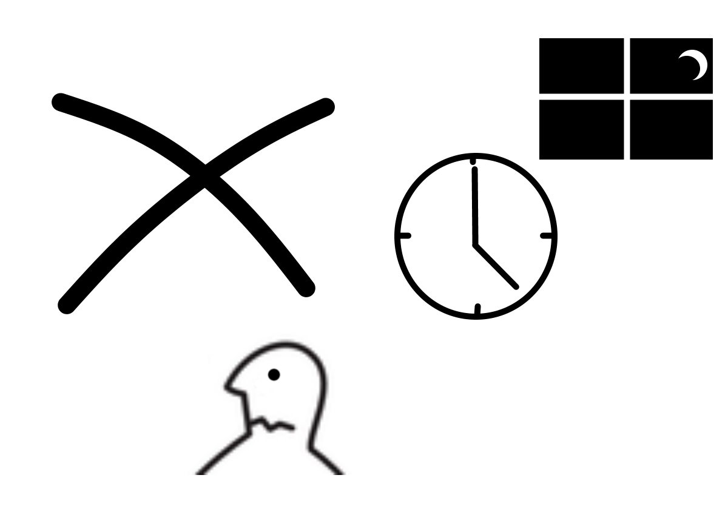
DON’T MAKE ONE PERSON DRIVE FOR TOO LONG
Notes:
NEIL
Don’t let one person drive too long.
Don’t let it always be your most senior person.
Pomodoro, whatever length fits – supposedly strict.
We tend to rotate at appropriate point (e.g. tests green, section finished).

Slide 22
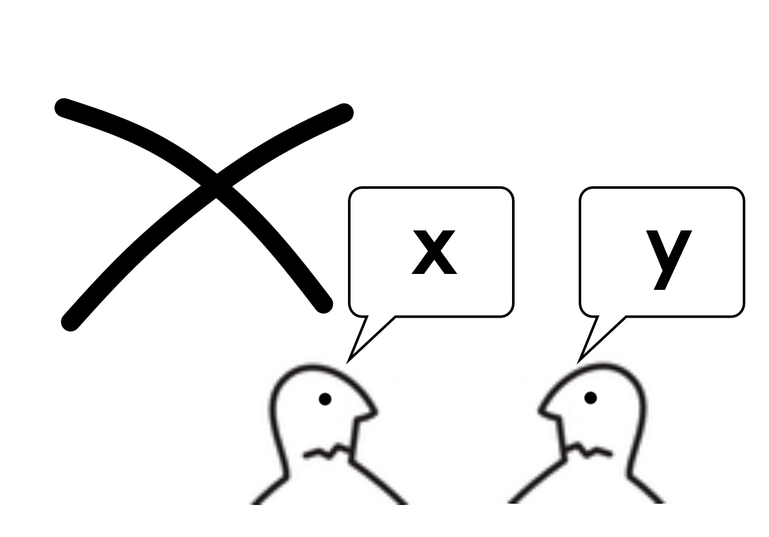
SUPPORT THE DRIVER
Notes:
NEIL
Just because driver is in the hotseat, doesn’t mean navigators should switch off.
Your role is just as important.
You’ll be driving again soon, you’ll need to know what’s going on!
As Oli said, if you need to split, just announce it and make sure you catch up on return.

Slide 23
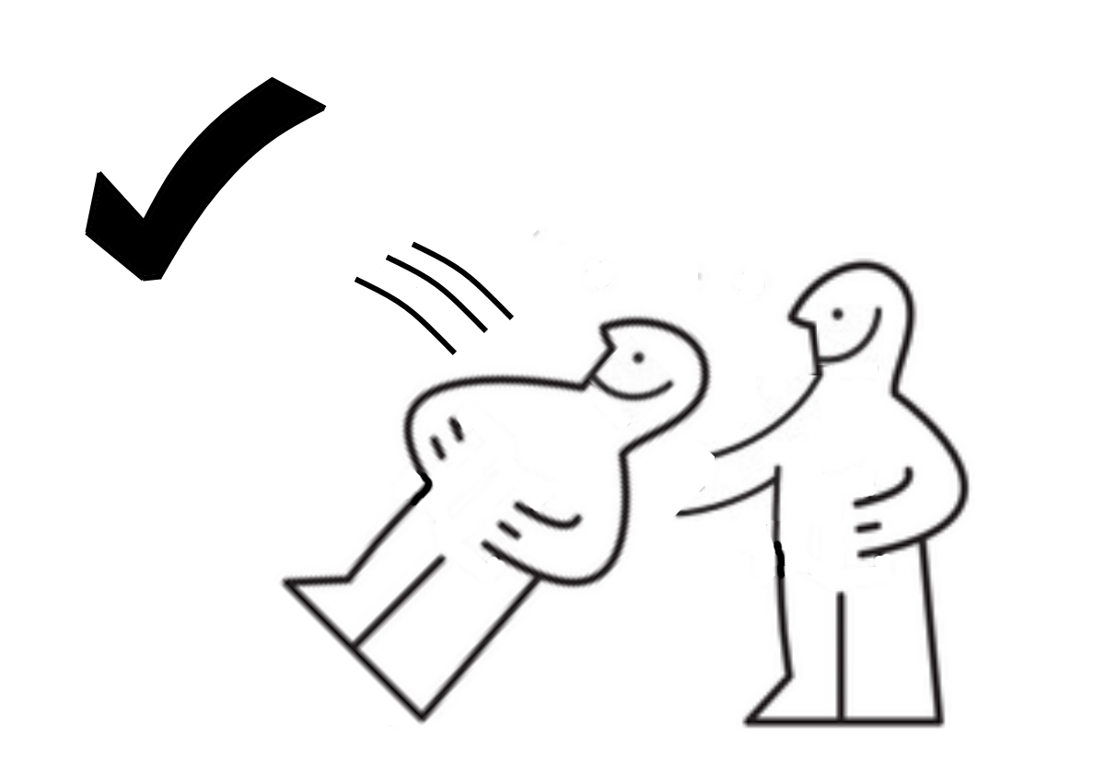
TRUST REQUIRED
Notes:
OLI -Everyone’s in the limelight – needs a safe/trusting environment​

Slide 24
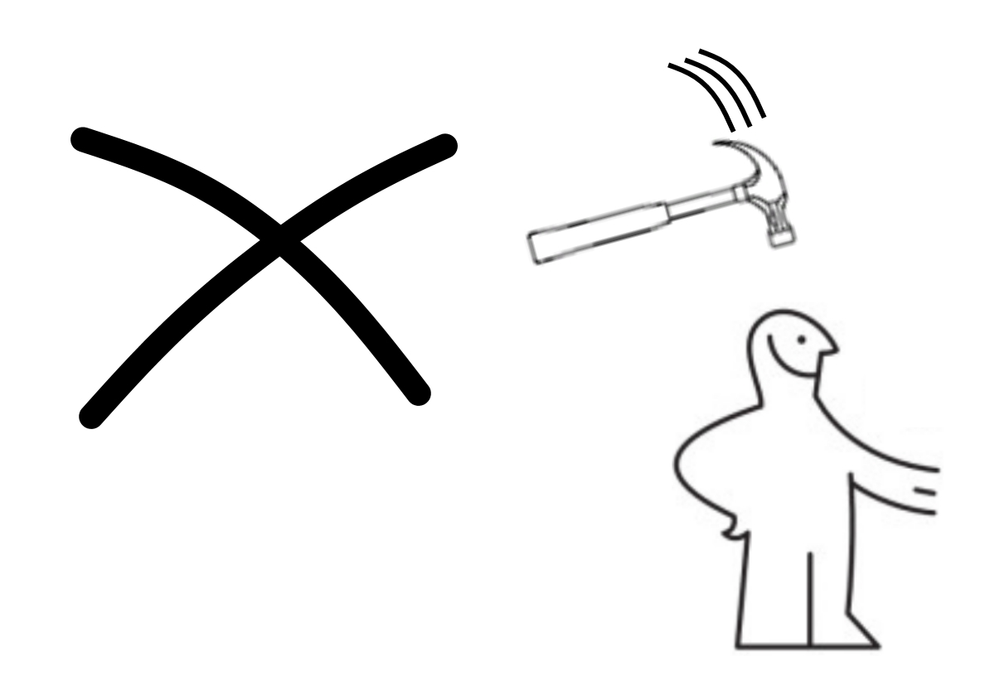
DON'T FORCE IT
Notes:
NEIL
You can't force a team to work this way.
Things Oli said – trust, openness, freedom of communication – comes with time.
New teams need to learn each other’s boundaries, what they’re comfortable with.
If you throw everyone in at the deep end – everyone might hate it!
Small steps, frequent retros.

Slide 25
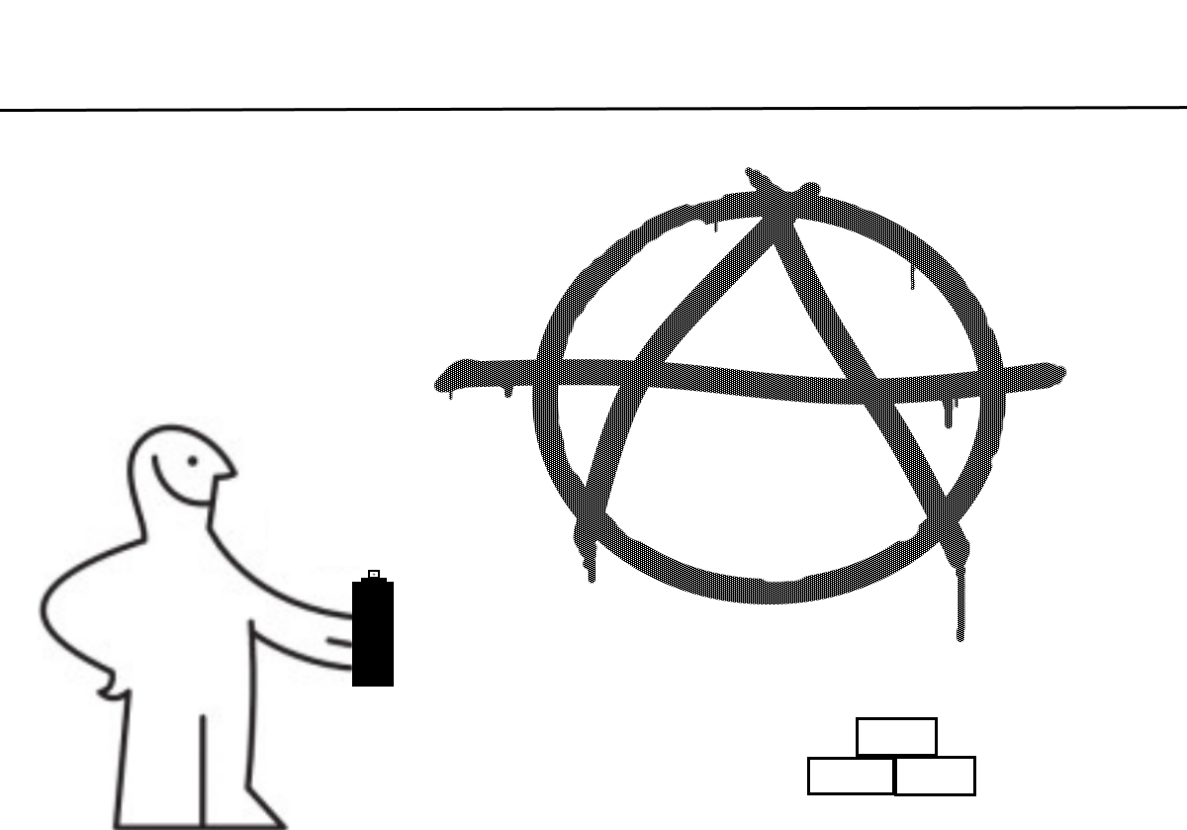
Notes:
NEIL -you can't force a team to work this way

Slide 26
Conclusion
Can be more productive (in the right situations)
Knowledge-sharing means less ramp-up time on related tasks
It’s worked for us – it might work for you
It’s easy to try
Contact us if you’d like some advice
Notes:
NEIL 1 & 2
OLI 3 & 4
Both – thanks!!

Slide 27
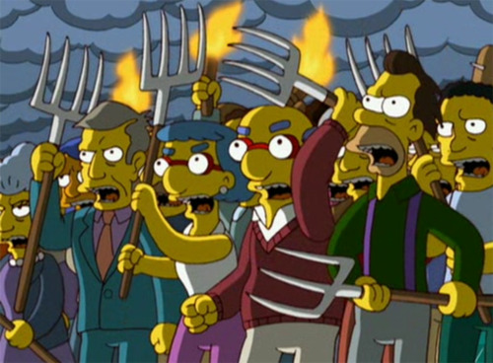
#MobProgramming

